Slide 1

Artificial Intelligence and Data Analysis
MFE204TC
Huakang Li
Huakang.li@xjtlu.edu.cn
School of AI and Advanced Computing
Notes:
English Title: Uppercase, Calibri size 60, XJTLU Navy
English Subtitle: Uppercase, Calibri size 36, XJTLU Navy

Slide 2
Chapter 12
Knowledge representation
Notes:
English Title: Uppercase, Calibri size 60, XJTLU Navy
English Subtitle: Uppercase, Calibri size 36, XJTLU Navy

Slide 3
outline
In which we show how to use first-order logic to represent the most important aspects of the real world, such as action, space, time, thoughts, and shopping.
Chapter List:
Ontological Engineering
Categories and Objects
Events
The Internet Shopping World
Notes:
Header: Uppercase, Calibri size 28, XJTLU Navy
Body Text: Sentence case, Calibri size 14, Black

Slide 4
Universal quantification
∀<variables> <sentence>
Everyone at UCB is smart:
∀x At(x,UCB) ⇒ Smart(x)
∀x P is true in a model m iff P is true with x being each possible object in the model
Roughly speaking, equivalent to the conjunction of instantiations of P
At(KingJohn,UCB) ⇒ Smart(KingJohn)
∧ At(Richard,UCB) ⇒ Smart(Richard)
∧ At(UCB,UCB) ⇒ Smart(UCB)
∧ ...

Slide 5
A common mistake to avoid
Typically, ⇒ is the main connective with ∀
Common mistake: using ∧ as the main connective with ∀:
∀x At(x,UCB) ∧ Smart(x)
means “Everyone is at UCB and everyone is smart”

Slide 6
Existential quantification
∃<variables> <sentence>
Someone at UCB is smart:
∃x At(x,UCB) ∧ Smart(x)
∃x P is true in a model m iff P is true with x being some possible object in the model
Roughly speaking, equivalent to the disjunction of instantiations of P
At(KingJohn,UCB) ∧ Smart(KingJohn)
∨ At(Richard,UCB) ∧ Smart(Richard)
∨ At(UCB,UCB) ∧ Smart(UCB)
∨ ...

Slide 7
Another common mistake to avoid
Typically, ∧ is the main connective with ∃
Common mistake: using ⇒ as the main connective with ∃:
∃x At(x,UCB) ⇒ Smart(x)
is true if there is anyone who is not at UCB!

Slide 8
Properties of quantifiers
∀x ∀y is the same as ∀y ∀x
∃x ∃y is the same as ∃y ∃x
∃x ∀y is not the same as ∀y ∃x
∃x ∀y Loves(x,y)
“There is a person who loves everyone in the world”
∀y ∃x Loves(x,y)
“Everyone in the world is loved by at least one person”
Quantifier duality: each can be expressed using the other
∀x Likes(x,IceCream) ¬∃x ¬Likes(x,IceCream)
∃x Likes(x,Broccoli) ¬∀x ¬Likes(x,Broccoli)

Slide 9
Some examples of FOL sentences
How expressive is FOL?
Some examples from natural language
Every gardener likes the sun.
∀x gardener(x) => likes (x, Sun)
You can fool some of the people all of the time
∃x (person(x) ^ (∀ t) (time(t) => can-fool(x,t)))
You can fool all of the people some of the time.
∀x (person(x) => (∃ t) (time(t) ^ can-fool(x,t)))
No purple mushroom is poisonous.
~ ∃x purple(x) ^ mushroom(x) ^ poisonous(x)
or, equivalently, ∀x (mushroom(x) ^ purple(x)) => ~poisonous(x)

Slide 10
Equality
term₁ = term₂ is true under a given interpretation if and only if term₁ and term₂ refer to the same object
E.g., definition of Sibling in terms of Parent:
∀x,y Sibling(x,y) ⇔ [¬(x = y) ∧ ∃m,f ¬ (m = f) ∧ Parent(m,x) ∧ Parent(f,x) ∧ Parent(m,y) ∧ Parent(f,y)]

Slide 11
Using FOL
The kinship domain:
Brothers are siblings
∀x,y Brother(x,y) ⇔ Sibling(x,y)
One's mother is one's female parent
∀m,c Mother(c) = m ⇔ (Female(m) ∧ Parent(m,c))
“Sibling” is symmetric
∀x,y Sibling(x,y) ⇔ Sibling(y,x)

Slide 12
Interacting with FOL KBs
Suppose a wumpus-world agent is using an FOL KB and perceives a smell and a breeze (but no glitter) at t=5:
Tell(KB,Percept([Smell,Breeze,None],5))
Ask(KB,∃a BestAction(a,5))
I.e., does the KB entail some best action at t=5?
Answer: Yes, {a/Shoot} ← substitution (binding list)
Given a sentence S and a substitution σ,
Sσ denotes the result of plugging σ into S; e.g.,
S = Smarter(x,y)
σ = {x/Hillary,y/Bill}
Sσ = Smarter(Hillary,Bill)
Ask(KB,S) returns some/all Sσ such that KB╞ σ

Slide 13
Inference in FOL
Entailment is defined exactly as for PL:
α |= β (“α entails β” or “β follows from α”) iff in every world where α is true, β is also true
E.g., ∀x Knows(x,Obama) entails ∃y∀x Knows(x,y)
If asked “Do you know what time it is?”, it’s rude to say “Yes”
Similarly, given an existentially quantified query, it’s polite to provide an answer in the form of a substitution (or binding) for the variable(s):
KB = ∀x Knows(x,Obama)
Query = ∃y∀x Knows(x,y)
Answer = Yes, {y/Obama}
Applying the substitution should produce a sentence that is entailed by KB

Slide 14
Inference in FOL: Propositionalization
Convert (KB ∧ ¬α) to PL, use a PL SAT solver to check (un)satisfiability
Trick: replace variables with ground terms, convert atomic sentences to symbols
∀x Knows(x,Obama) and Democrat(Feinstein)
Knows(Obama,Obama) and Knows(Feinstein,Obama) and Democrat(Feinstein)
K_O_O ∧ K_F_O ∧ D_F
and ∀x Knows(Mother(x),x)
Knows(Obama,Obama) and Knows(Mother(Obama),Obama) and Knows(Mother(Mother(Obama)),Obama) …….
Real trick: for k = 1 to infinity, use terms of function nesting depth k
If entailed, will find a contradiction for some finite k; if not, may continue for ever; semidecidable

Slide 15
Inference in FOL: Lifted inference
Apply inference rules directly to first-order sentences, e.g.,
KB = Person(Socrates), ∀x Person(x) ⇒ Mortal(x)
conclude Mortal(Socrates)
The general rule is a version of Modus Ponens:
Given α[x] ⇒ β[x] and α’, where α’σ = α[x]σ for some substitution σ conclude β[x] σ
σ is {x/Socrates}
Given Knows(x,Obama) and Knows(y,z) ⇒ Likes(y,z)
σ is {y/x, z/Obama}, conclude Likes(x,Obama)
Examples: Prolog (backward chaining), Datalog (forward chaining), production rule systems (forward chaining), resolution theorem provers

Slide 16
KB for the wumpus world
Perception
∀t,s,b Percept([s,b,Glitter],t) ⇒ Glitter(t)
Reflex
∀t Glitter(t) ⇒ BestAction(Grab,t)

Slide 17
Deducing hidden properties
∀x,y,a,b Adjacent([x,y],[a,b]) ⇔
[a,b] ∈ {[x+1,y], [x-1,y],[x,y+1],[x,y-1]}
Properties of squares:
∀s,t At(Agent,s,t) ∧ Breeze(t) ⇒ Breezy(s)
Squares are breezy near a pit:
Diagnostic rule---infer cause from effect
∀s Breezy(s) ⇒ ∃ r Adjacent(r,s) ∧ Pit(r)
Causal rule---infer effect from cause
∀r Pit(r) ⇒ [∀s Adjacent(r,s) ⇒ Breezy(s) ]

Slide 18
Universal instantiation (UI)
Every instantiation of a universally quantified sentence is entailed by it:
v α
Subst({v/g}, α)
for any variable v and ground term g
E.g., ∀x King(x) ∧ Greedy(x) ⇒ Evil(x) yields any or all of:
King(John) ∧ Greedy(John) ⇒ Evil(John)
King(Richard) ∧ Greedy(Richard) ⇒ Evil(Richard)
King(Father(John)) ∧ Greedy(Father(John)) ⇒ Evil(Father(John))
…

Slide 19
Existential instantiation (EI)
For any sentence α, variable v, and constant symbol k that does not appear elsewhere in the knowledge base:
∃v α
Subst({v/k}, α)
E.g., ∃x Crown(x) ∧ OnHead(x,John) yields:
Crown(C1) ∧ OnHead(C1,John)
provided C1 is a new constant symbol, called a Skolem constant

Slide 20
Existential Instantiation continued
UI can be applied several times to add new sentences
the new KB is logically equivalent to the old
EI can be applied once to replace the existential sentence
the new KB is not equivalent to the old
but a sentence is entailed by the old KB iff it is entailed by the new KB.

Slide 21
Reduction to propositional inference
Suppose the KB contains just the following:
∀x King(x) ∧ Greedy(x) ⇒ Evil(x)
King(John)
Greedy(John)
Brother(Richard,John)
Instantiating the universal sentence in all possible ways, we have:
King(John) ∧ Greedy(John) ⇒ Evil(John)
King(Richard) ∧ Greedy(Richard) ⇒ Evil(Richard)
King(John)
Greedy(John)
Brother(Richard,John)
The new KB is propositionalized: proposition symbols are
King(John), Greedy(John), Evil(John), King(Richard), etc.

Slide 22
Reduction contd.
Claim: Every FOL KB can be propositionalized so as to preserve entailment
(A ground sentence is entailed by new KB iff entailed by original KB)
Idea: propositionalize KB and query, apply resolution, return result
Problem: with function symbols, there are infinitely many ground terms,
e.g., Father(Father(Father(John)))

Slide 23
Reduction contd.
Theorem: Herbrand (1930). If a sentence α is entailed by an FOL KB, it is entailed by a finite subset of the propositionalized KB
Idea: For n = 0 to ∞ do
create a propositional KB by instantiating with depth-n terms
see if α is entailed by this KB
Problem: works if α is entailed, keeps instantiating and doesn’t terminate if α is not entailed
Theorem: Turing (1936), Church (1936) Entailment for FOL is semidecidable (algorithms exist that say yes to every entailed sentence, but no algorithm exists that also says no to every nonentailed sentence.)

Slide 24
Problems with propositionalization
Propositionalization seems to generate lots of irrelevant sentences.
E.g., from: ∀x King(x) ∧ Greedy(x) ⇒ Evil(x) King(John) ∀y Greedy(y) Brother(Richard,John) it seems obvious that Evil(John), but propositionalization produces lots of facts such as Greedy(Richard) that are irrelevant
With p k-ary predicates and n constants, there are p·n^{k} instantiations.
With function symbols, it gets worse!

Slide 25
Methods to speed up inference
Unification
Resolution with search heuristics.
Backward Chaining/ Prolog
Paramodulation
There is a technology of theorem proving.

Slide 26
What you need to know
Basic concepts of logic
Entailment, validity, satisfiability
Logical equivalence in propositional logic (rewrite rules)
Propositional Logic
Syntax, Semantics
Models, and truth table enumeration for model checking
Reduction to CNF using logical equivalence rules
Propositional resolution
FOL
Syntax, Semantics
Quantifiers
Writing sentences with quantifiers in FOL.

Slide 27
Knowledge engineering in FOL
Identify the task
Assemble the relevant knowledge
Decide on a vocabulary of predicates, functions, and constants
Encode general knowledge about the domain
Encode a description of the specific problem instance
Pose queries to the inference procedure and get answers
Debug the knowledge base

Slide 28
Knowledge Representation
Encoding real world knowledge in a formalism that allows us to access it and reason with it
Requires a method to conceptualize the world in a formal language
Such a formalization is an ontology

Slide 29
Ontology: Origins and History
Ontology in Philosophy
a philosophical discipline—a branch of philosophy that
deals with the nature and the organisation of reality
Science of Being (Aristotle, Metaphysics, IV, 1)
Tries to answer the questions:
What characterizes being?
Eventually, what is being?
How should things be classified?

Slide 30
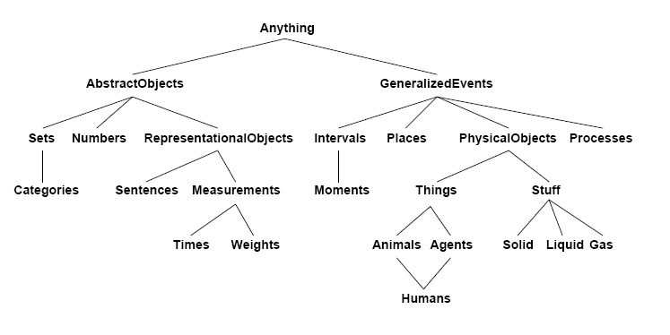
A possible upper ontology

Slide 31
A special purpose ontology
vegetable (Color, Flavor, Calories,Vitamins,Plant)
root vegetable gourd nightshade
(_,_,_,_,root) (_,_,_,_,vine) (_,_,_,_,shrub)
carrots turnips zucchini pumpkins eggplant tomatoes
(or,sw,31,c,_) (white,bi,39,c,_) (gr,bi,29,f,_) (or,sw,30,cf,_) (purple,sw,21,c,_) (red,sw,26,c,_)
Abbreviations: or – orange, gr-green, sw-sweet, bi-bitter, f-folate
Notes:
This is the usual direction we think of...seems “goal directed”
P⇒Q start from Q and find the P’s that would establish; usually better than starting from the P’s and seeing everything that’s implied
draw the implication arrows on this tree so can see that going against the implication when go up the tree (cf. next version where going with the arrows when go up tree)

Slide 32
Categories and objects
KR requires the organization of objects into categories
Interaction at the level of the object
Reasoning at the level of categories
Categories play a role in predictions about objects
Based on perceived properties
Categories can be represented in two ways by FOL
Predicates: apple(x)
Reification of categories into objects: apples
Category = set of its members

Slide 33
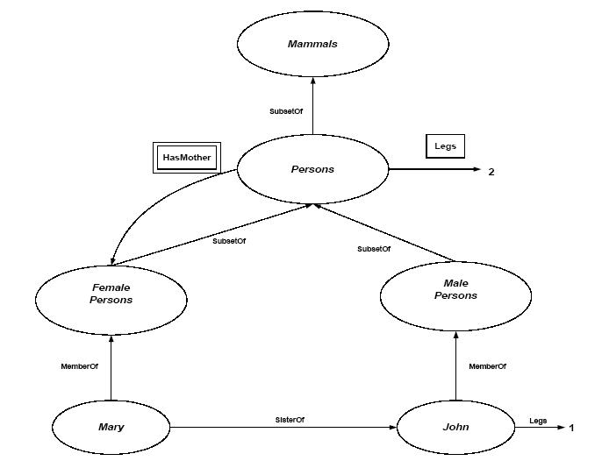
Category organization
Subset Relation → inheritance:
All instance of food are edible, fruit is a subclass of food and apples is a subclass of fruit then an apple is edible.
Defines a taxonomy

Slide 34
FOL and categories
An object is a member of a category
MemberOf(BB₁₂,Basketballs)
A category is a subclass of another category
SubsetOf(Basketballs,Balls)
All members of a category have some properties
∀ x (MemberOf(x,Basketballs) ⇒ Round(x))
All members of a category can be recognized by some properties
∀ x (Orange(x) ∧ Round(x) ∧ Diameter(x)=9.5in ∧ MemberOf(x,Balls) ⇒ MemberOf(x,BasketBalls))
A category as a whole has some properties
MemberOf(Dogs,DomesticatedSpecies)

Slide 35
So what
Can we use formal categories in real world applications?

Slide 36
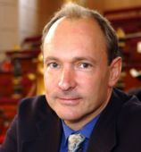
Semantic Web
HTML was “invented” by Tim Berners-Lee (amongst others), a physicist working at CERN
His vision of the Web was much more ambitious than the reality of the existing (syntactic) Web:
This vision of the Web has become known as the Semantic Web
“… a plan for achieving a set of connected applications for data on the Web in such a way as to form a consistent logical web of data …”
“… an extension of the current web in which information is given well-defined meaning, better enabling computers and people to work in cooperation …”

Slide 37
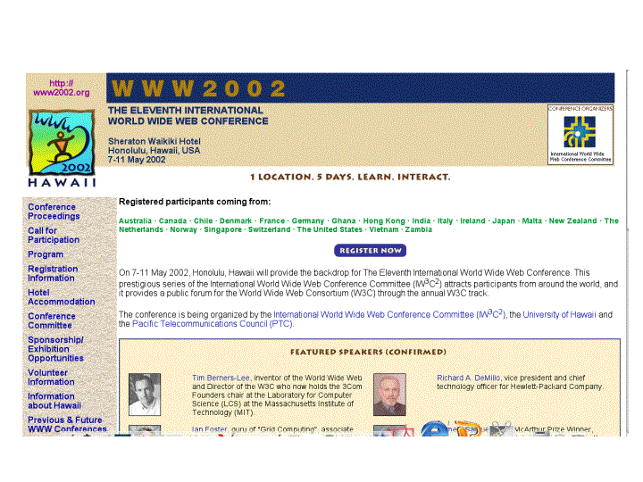
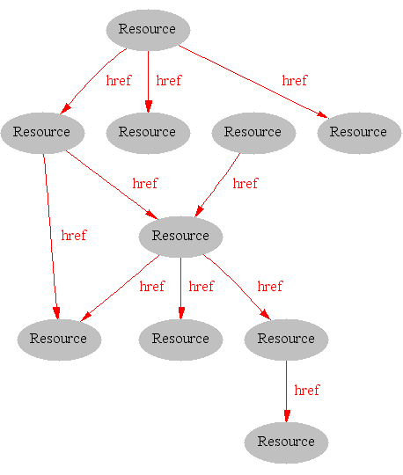
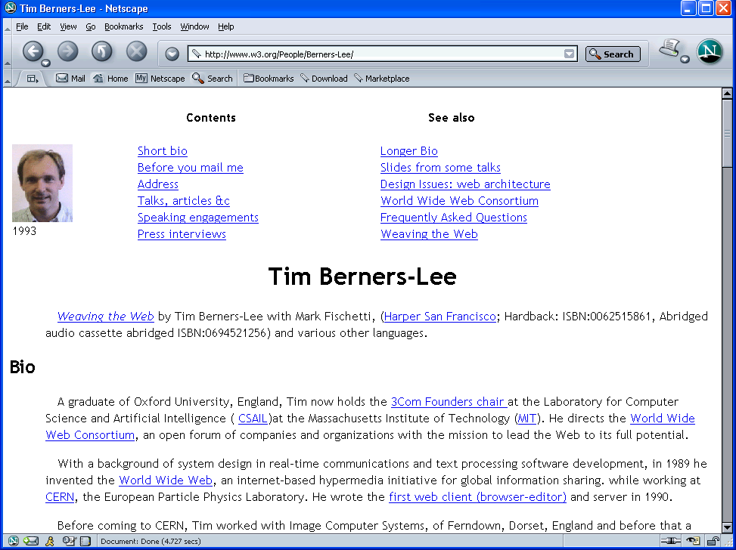
Where we are Today: the Syntactic Web
[Hendler & Miller 02]

Slide 38
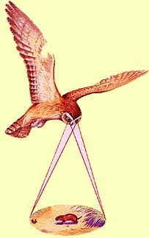
Impossible using the Syntactic Web…
Complex queries involving background knowledge
Find information about “animals that use sonar but are not either bats or dolphins”
Locating information in data repositories
Travel enquiries
Prices of goods and services
Results of human genome experiments
Finding and using “web services”
Visualise surface interactions between two proteins
Delegating complex tasks to web “agents”
Book me a holiday next weekend somewhere warm, not too far away, and where they speak French or English
, e.g., Barn Owl

Slide 39
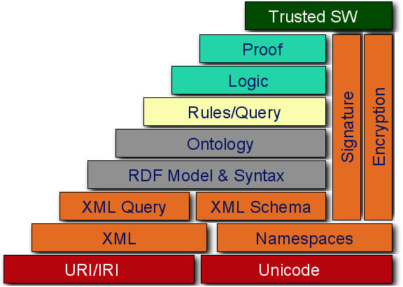
A Layered Web

Slide 40
Ontology Working Language (OWL)
http://www.w3.org/TR/owl-features

Slide 41
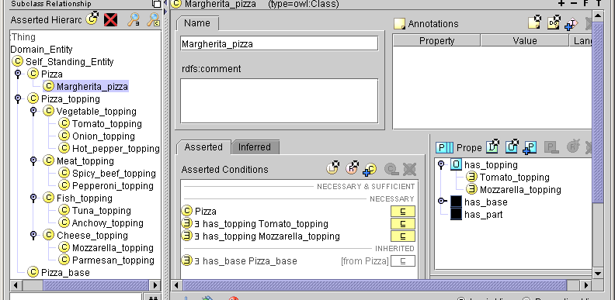
A Pizza ontology
someValuesFrom restrictions
Properties subpane showing alternative ‘frame’ view
What it means
All Margherita_pizzas (amongst other things)
Are Pizzas
have_topping some Tomato_topping
have_topping some Mozzarella_topping
& because they are Pizzas have_base some Pizza_base

Slide 42
Current Status
Many general purpose logical ontologies in owl on the machine readable web
CYC
SUMO
Special purpose logical systems in routine use
UMLS medical ontology
EcoCYC metabolic pathway database
Just type “semantic web” on Google.
Check the Wikipedia entry for starters.

Slide 43
Scientific American, May 2001:
Realising the complete “vision” is too hard for now (probably)
But we can make a start by adding semantic annotation to web resources

Slide 44
Buying a book : Actions in FOL
Actions change the state of the world.
Not easy to capture this in FOL (why?)
Action Buy (x, book, amazon)
Precondition: have (x, credit) /\ has_in_stock(amazon, book)…
Effect: charge(card) /\ ship(amazon, book, address(x))
Frame Problem
Specifying things that don’t change (need Action x Fluents axioms)
Ramification problem
Capturing indirect effects
Qualification problem
Completeness of preconditions

Slide 45
Necessary and Sufficient conditions
Many categories have no clear-cut definitions
E.G. (chair, bush, book)
Tomatoes: sometimes green, red, yellow, black. Mostly round.
One solution: category Typical(Tomatoes)
∀ x ∈ Typical(Tomatoes) ⇒ Red(x) ∧ Spherical(x)
We can write down useful facts about categories without providing exact definitions.
What about “bachelor”? Philosophers (Quine, Fodor) and linguists (Fillmore) challenge the utility or possibility of the notion of strict definition. We might question a statement such as “the Pope is a bachelor”.

Slide 46
Structure of concepts
Instead complex concepts exhibit a radial structure often with a prototypical member and a number of mappings and extensions.
Prototypes of categories could arise from various considerations including
a) being a central category (others relate to it; amble and swagger relate to the prototype walk),
b) being an essential feature that meets a folk theory (birds have feathers, lay eggs),
c) being a typical case (sparrow is a typical bird),
d) being an ideal positive social standard (“parent) or an anti-ideal negative social standard (“terrorist”),
e) a stereotype (set of assumed attributes as in dumb blonde) or
f) a salient exemplar (second world war as a just war)

Slide 47
Summary
First-order logic:
objects and relations are semantic primitives
syntax: constants, functions, predicates, equality, quantifiers
Increased expressive power: sufficient to express real-world problems
Problems:
Handling human conceptual categories, uncertainty and dynamics
Next week: Modern AI: Probability
READ Chapter 13!!

Slide 48



THANK YOU
Visit us
FOLLOW us
www.xjtlu.edu.cn
@xjtlu
Notes:
Title: Uppercase, Calibri size 60, XJTLU Navy

